Slide 1
Functions in C

Slide 2
Agenda
• Function definition.
• Function Types.
• Function Syntax.
• Function Recursion.
• Local and Global variables.
• Block scope.
• Divide project to many C files

Slide 3
What is function ?
• A function is a block of code that will be defined one time and can be executed many times.
• To execute the function you will need to call it.
The function provides you with the advantage that it is defined one time and can be executed many times so it takes the same size in the memory whatever how many times it would be called.

Slide 4
What is function ?
When you call a function, you can send to it some inputs and it could return back an output.

Slide 5
Function Types
There are two types of functions in C programming:
1- User defined functions :
function is defined and given its name by the user to perform a specific task .
2- Standard Library function :
a built in functions that has a certain name and take certain arguments previously defined in the standard library.

Slide 6
Function Syntax
1- The prototype : Used to declare the function .
return_type Function_Name (Input_Type Input_Name , …… );
2- The function body (The implementation ) : Used to define the function behavior
return_type Function_Name (Input_Type Input_Name , ……)
{
Function statements
}
3- Function call Used to execute the function.
Output = Function_Name(Inputs) ;

Slide 7
Example

Slide 8
Exercise
Write a C function to calculate the factors of a number .
Ex : factors of 25 : 1,5,25
Write a C function to calculate the power of a number .

Slide 9
Void keyword
The void keyword is used to any function to give the meaning of Nothing.
For example if we need to define a function that takes no arguments,
we would write between its ( ) the keyword void.
If we need to define a function that doesn’t return any outputs,
we will write instead of the return type the keyword void
.Example :
void printWelcome(void)
{
printf(“wlcome Ahmed”);
}

Slide 10
Notes
Trying to receive an output from a function that returns void will give Compilation error.
Trying to send an input from a function that takes void will give Compilation error.
3. Trying to send fewer or more arguments than Declared in a function prototype/ implementation gives Compilation error.

Slide 11
Local Vs Global variable
Local variable is a variable that will be identified or seen only within a function scope or block scope. Local variables are saved in stack section in RAM, unless it has the modifier static. it is saved in data segment.
Global variable is a variable outside of any function , that is why it is seen from all the function in the same file , it has a file scope or project scope. Global variables are put in data segment section in RAM . Uninitialized global variables are initialized to zero by default.

Slide 12
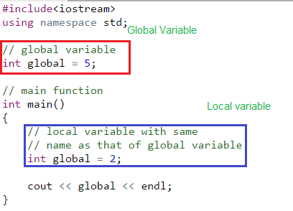

Slide 13
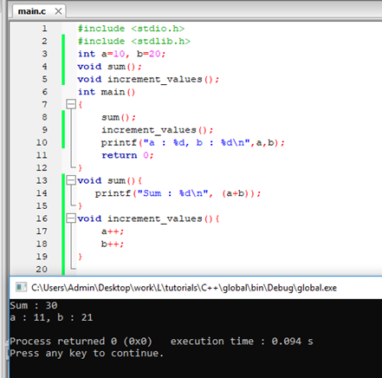

Slide 15
Block scope
• Blocks combine multiple statements into a single unit .
• Variables declared inside the block have a local scope.
• Blocks can be nested.

Slide 18
Divide project to many C files
• We divide a large C project to modules based on functionality .
• Each module is composed of a .c file and a .h file.
• A .c file contains the following :
1- Implementation of functions .
2- Global variable definition.
• A .h file contains the following:
1- constants (#define) .
2- functions prototype.

Slide 19
Recursion
A function that calls itself is known as a recursive function. And, this technique is known as recursion.
Recursion in not recommended in Embedded Systems development because it uses more memory and is generally slow.

Slide 21
Assignment
1- Write a C function to print Fibonacci series given the
number of terms.
2- Design a program composed of the following:
Math Library filles:MathLib.c and MathLib.h
Math Library functions: add,sub,multi,and dev
And make a programe by using this library.

Slide 22
Thank you

